Slide 1
Weekly Update #1
Gijs Admiraal

Slide 2
What I have done
Read and summarized the paper “Atom-by-atom protein generation and beyond with language models”
Created a small mindmap
Looked at some other interesting papers
A. Kirschning (2022) - On the Evolutionary History of the Twenty Encoded Amino Acids
J.B. Ingraham et al. (2023) - Illuminating protein space with a programmable generative model
D. Flam-Shepherd et al. (2022) - Language models can learn complex molecular
Started on a RDKit tutorial
Made a question document

Slide 3
What I have done
Read and summarized the paper “Atom-by-atom protein generation and beyond with language models”
Created a small mindmap
Looked at some other interesting papers
A. Kirschning (2022) - On the Evolutionary History of the Twenty Encoded Amino Acids
J.B. Ingraham et al. (2023) - Illuminating protein space with a programmable generative model
D. Flam-Shepherd et al. (2022) - Language models can learn complex molecular
Started on a RDKit tutorial
Made a question document

Slide 4
What I have done
Read and summarized the paper “Atom-by-atom protein generation and beyond with language models”
Created a small mindmap
Looked at some other interesting papers
A. Kirschning (2022) - On the Evolutionary History of the Twenty Encoded Amino Acids
J.B. Ingraham et al. (2023) - Illuminating protein space with a programmable generative model
D. Flam-Shepherd et al. (2022) - Language models can learn complex molecular
Started on a RDKit tutorial
Made a question document

Slide 5
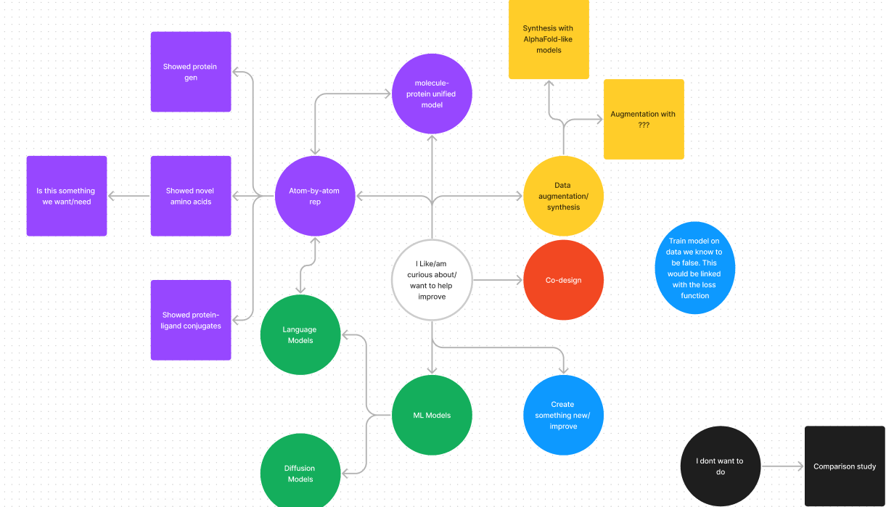
Mindmap

Slide 6
What I have done
Read and summarized the paper “Atom-by-atom protein generation and beyond with language models”
Created a small mindmap
Looked at some other interesting papers
A. Kirschning (2022) - On the Evolutionary History of the Twenty Encoded Amino Acids
J.B. Ingraham et al. (2023) - Illuminating protein space with a programmable generative model
D. Flam-Shepherd et al. (2022) - Language models can learn complex molecular
Started on a RDKit tutorial
Made a question document

Slide 7
What I have done
Read and summarized the paper “Atom-by-atom protein generation and beyond with language models”
Created a small mindmap
Looked at some other interesting papers
A. Kirschning (2022) - On the Evolutionary History of the Twenty Encoded Amino Acids
J.B. Ingraham et al. (2023) - Illuminating protein space with a programmable generative model
D. Flam-Shepherd et al. (2022) - Language models can learn complex molecular
Started on a RDKit tutorial
Made a question document

Slide 8
What I have done
Read and summarized the paper “Atom-by-atom protein generation and beyond with language models”
Created a small mindmap
Looked at some other interesting papers
A. Kirschning (2022) - On the Evolutionary History of the Twenty Encoded Amino Acids
J.B. Ingraham et al. (2023) - Illuminating protein space with a programmable generative model
D. Flam-Shepherd et al. (2022) - Language models can learn complex molecular
Started on a RDKit tutorial
Made a question document

Slide 9
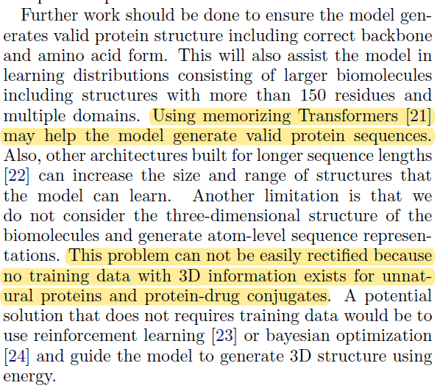
Questions

Slide 10
Questions
Look together at my questions document?

Slide 11
Next week?
Read more
Summarize other flam-shepherd paper
Write about/understand (chemical) language models
Delve more into the evolution of amino acids

Slide 12
notes
Challenges for synthetic amino acids
Slide with what I did in the previous weeks
Data analysis
Look at codes

